Slide 1


Sage 100
Not only a new
Strategic Product Vision 2026

Slide 2



Today's Speakers
Leadership
Technology
Product Strategy
David Klecel
Valentin Berthel
Nicolas Jacques
VP Sales
CEO of Genysia
Strategic Product Manager
Leading the commercial strategy and customer acquisition
Tech Partner & AI Expert driving innovation
Sage 50/100 France Vision & Execution

Slide 3






Sage 100 Today: The Challenges
Critical issues impacting growth & customer retention
14%
Operational & Product Pain Points
Churn Rate (High Risk)
Difficulty Moving to SPC (Cloud Hosting)
Migration friction remains high, slowing down the modernization of the installed base.
Declining
No Usage Data Visibility
New Customer Acquisition (NCA)
Zero data to understand user behavior, making proactive care and retention strategies impossible.
Low
Fragmented, Multi-Layer Experience
Product core is stuck; innovation comes from disconnected services (SSM, Connect, Knowledge Base), creating a disjointed user journey.
Cloud Adoption Velocity
Note: These challenges are not specific to France but are shared by all cloud-connected products across our markets.

Slide 4





Customer Base: Migration Paths
Total Customer Base
37,000 Clients
Top 10-20%
~5k Clients
Sage Intacct
Complex Finance Needs
€110M ARR
Main Target
At Risk in Core Segment
Core 60-80%
~27k Clients
Modernized Sage 100
Staying on Sage 100 (Long-term)
"Modernized Sage 100 targets the 60-80% core segment staying long-term."
Bottom 10-20%
~5k Clients
Sage Active
Simple Needs / Cloud Native
4/12

Slide 5


Cloud Connected Products have
30+ Years of Business Expertise
An accumulated functional depth that
no competitor can catch up in the 2 years ahead.
Unbeatable Functional Moat

Slide 6

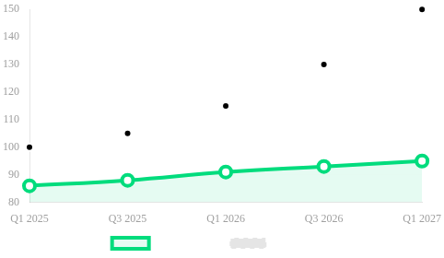




Our Ambition: Return to Conquest Mode
Strategic Goals 2026
-60%
Drastically Reduce Churn
Targeting 5-7% churn rate (down from 14%) by delivering tangible value through Modernized Sage 100.
PROJECTED GROWTH
Reignite NCA Growth
Launch a modern, competitive offering that attracts new customers and simplifies the sales process.
Innovation Leadership
Position Sage as the most innovative SMB solution with cutting-edge AI and seamless UX.
E-Invoicing Catalyst
Leverage the Sept 2026 reform as a unique market opportunity for massive adoption and customer acquisition.

Slide 7



Our Vision: 3 Experiences Transformed
Customer Experience
Partner Experience
Employee Experience
Modern & Reactive Interfaces
AI Studio for Innovation
Innovative Product to Sell
Centralized Sage Hub
Portfolio Data Access
Unified Tools & Metrics
Integrated Agentic AI
Open APIs Ecosystem
End-to-End Ownership

Slide 8







Technical Architecture
From fragmented multi-layer to unified experience
Layer 4
UNIFIED EXPERIENCE
Unified Product Experience
Open Ecosystem
Internal & External
(Single, cohesive experience across all devices)
Layer 3
USER FACING
New Web UI/UX
Sage AI Studio
For End Users
For Partners
Layer 2
CONNECTION
MCP (Model Context Protocol)
+ APIs Link Layer
Layer 1
BACK-OFFICE ENGINE
Sage 100 SPC / Hosted on Azure
(Powerful Functional Backend Asset)
Transforming a complex backend into a seamless modern experience

Slide 9

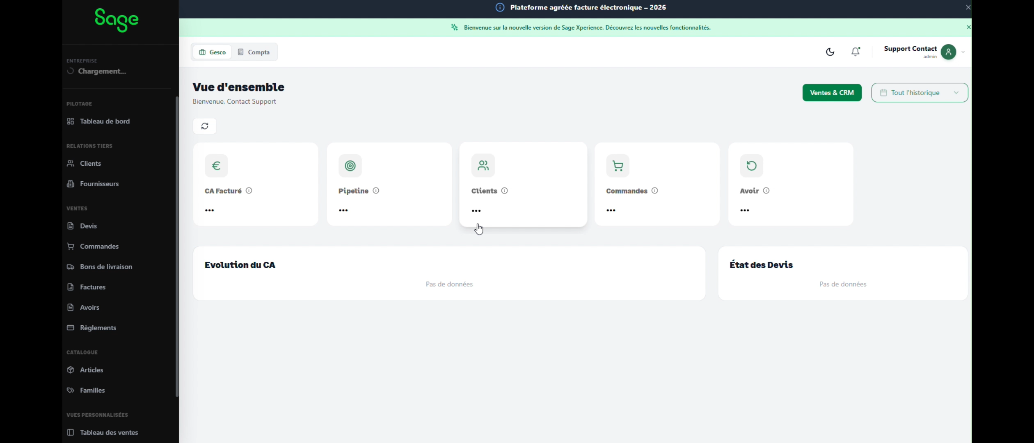






Web Ergonomics : Speed & Modernity
Hyper-Reactive Interface
Local cache technology delivers extreme speed. A major advantage over SPC hosting latency.
Web Access Anywhere
Fully responsive architecture. Optimized for seamless use on desktop, tablet, and mobile.
Modern & Intuitive
Frictionless workflows and clean design reduce user training time and errors.
Competitive Edge
Sets a new market standard for speed and usability vs. competitors.
Unified Hub Experience
All services centralized in one platform (e-invoicing, knowledge base, support, marketplace).
Data-Driven Intelligence
Real-time usage analytics to optimize user experience and business decisions.

Slide 10

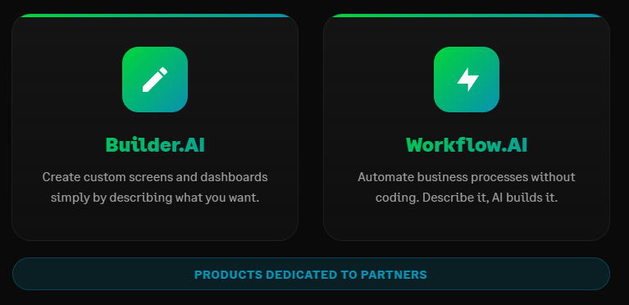

Slide 11
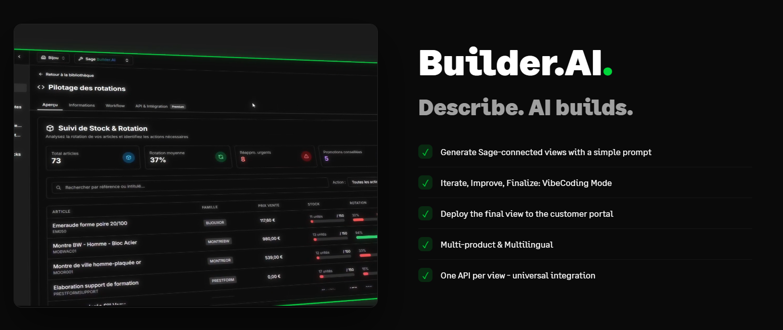

Slide 12
Making Sage portal the customer Hub.
Image avec produits Sage, et autres (CRM, ……)

Slide 13
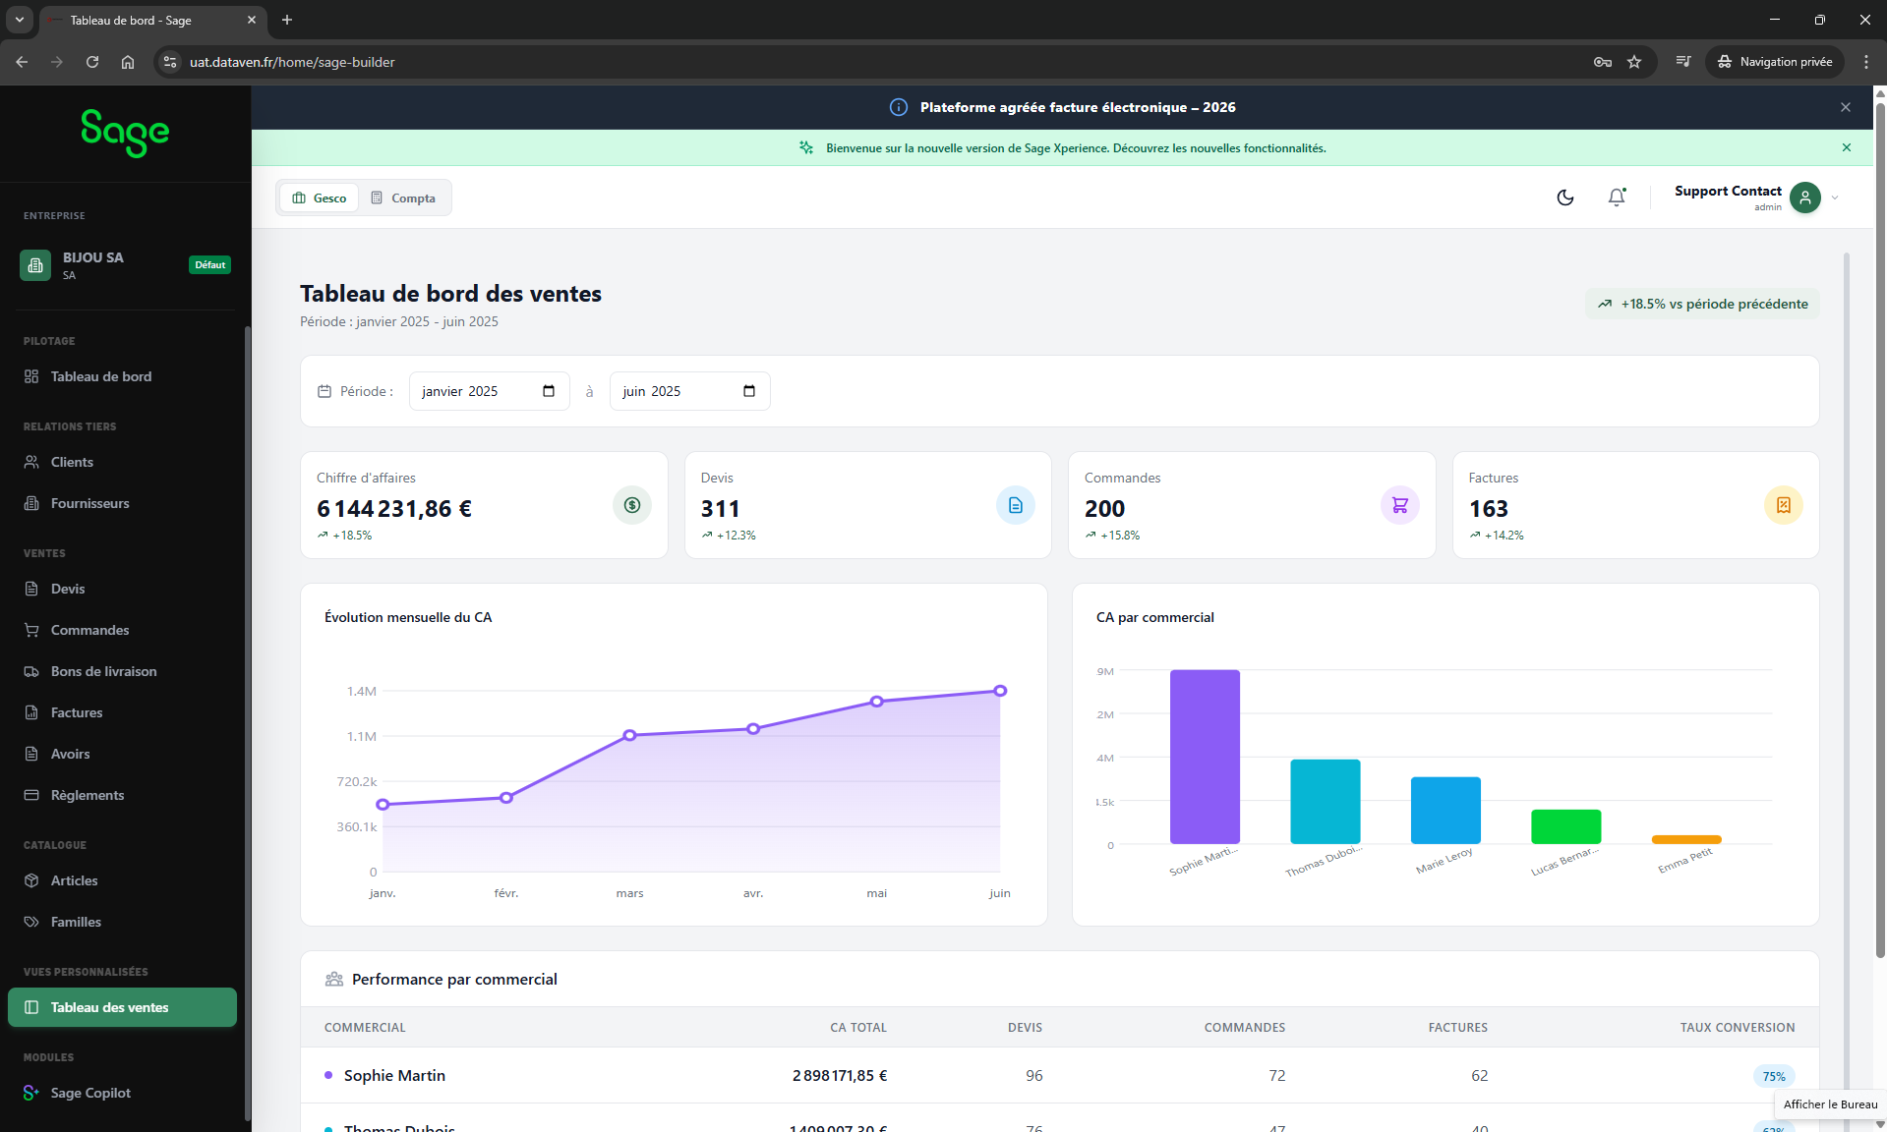

Accessible via the customer portal.

Slide 14
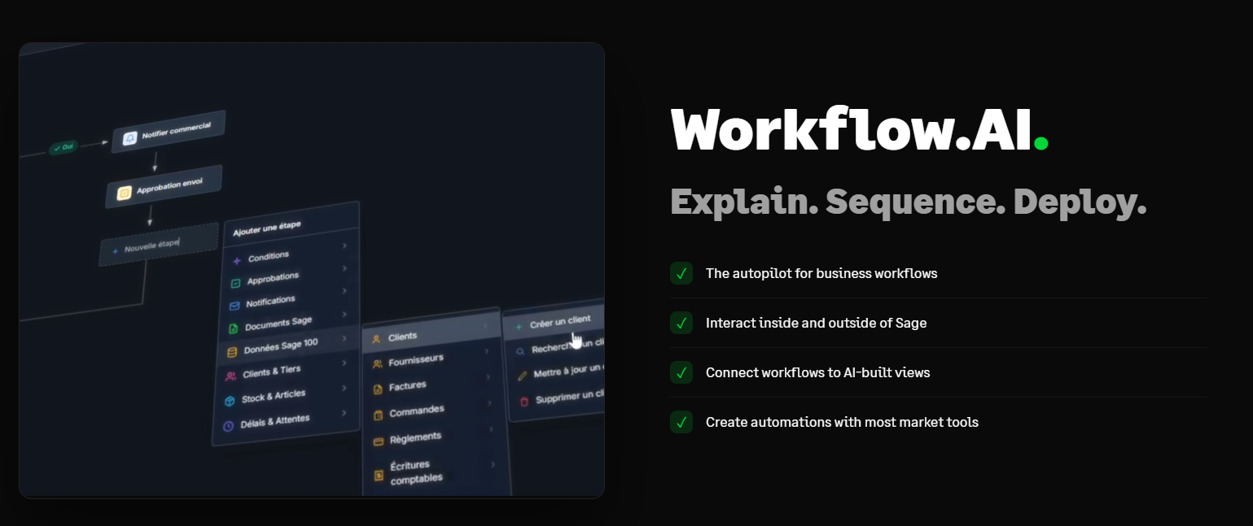

Slide 15
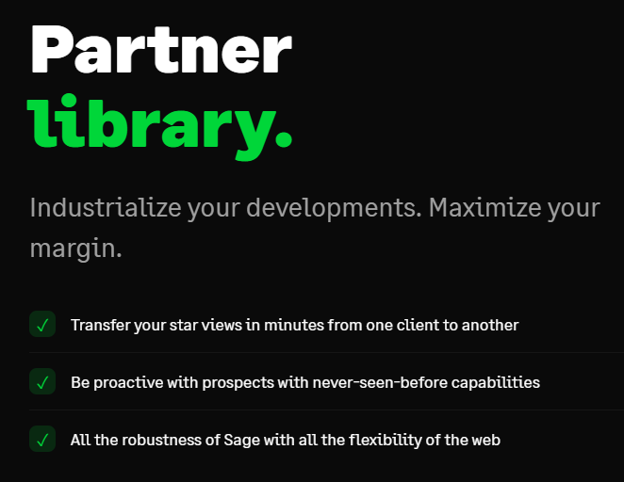

Slide 16
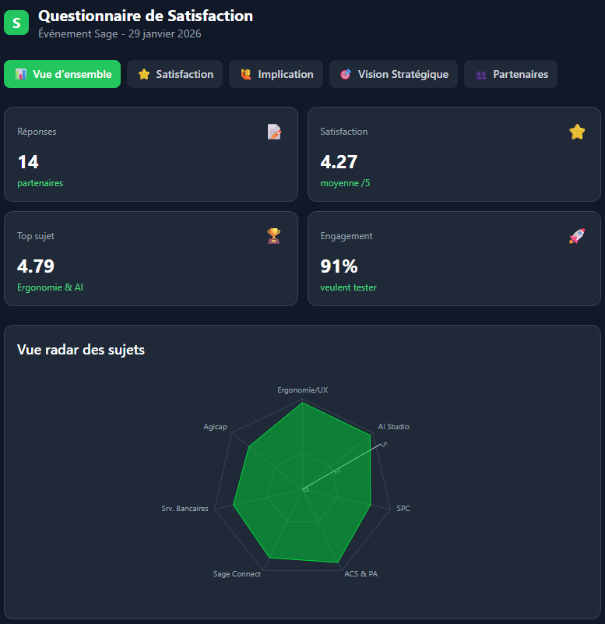
Already acclaimed by our TOP 20 partners.

Slide 17
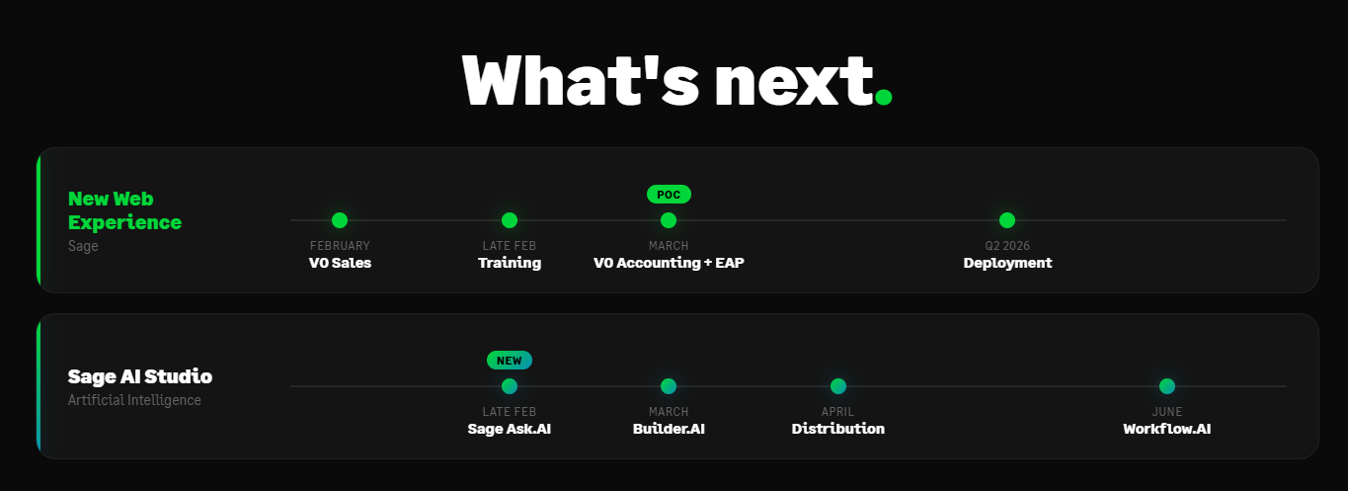

Slide 18
Appendix

Slide 19







New Product Experience:
Including What's Not in the Product (Yet)
Bringing external ecosystem services into a unified user journey
Knowledge Base & Sage University
Electronic Invoicing
Customer Support
Seamless compliance with new regulations. Integrated directly into the daily workflow, replacing disconnected tools.
Contextual learning resources and documentation accessible exactly when the user needs them.
Centralized ticket management and support access for faster resolution times without leaving the platform.
User Management
Marketplace
Billing & Subscriptions
Unified administration for roles, permissions, and team access across all services.
Curated ecosystem of apps and integrations to extend platform capabilities seamlessly.
Transparent view of usage, invoices, and subscription management in one portal.
Extending the core product boundary to include all daily touchpoints

Slide 20














Data at the Core of Every Decision
Decisions based on facts, not intuition
Customer Data
Partner Data
Employee Data
Real-time usage tracking across features
Portfolio health visibility dashboard
CSM Teams
Factual improvement based on behavioral patterns
Detection of early churn signals
Identification of upsell opportunities
Product Teams
Continuous optimization loop for UX refinement
Action prioritization for CSMs
Measure initiative impact at 1 year

